Slide 1
Sharding- An Overivew
Stefanos Logothetis
11/6/2019

Slide 2

Sharding- What is it?
Splits data among multiple machines in a network- built in horizontal scaling
Different from vertical scaling in that it doesn’t involve upgrading a single machine

Slide 3
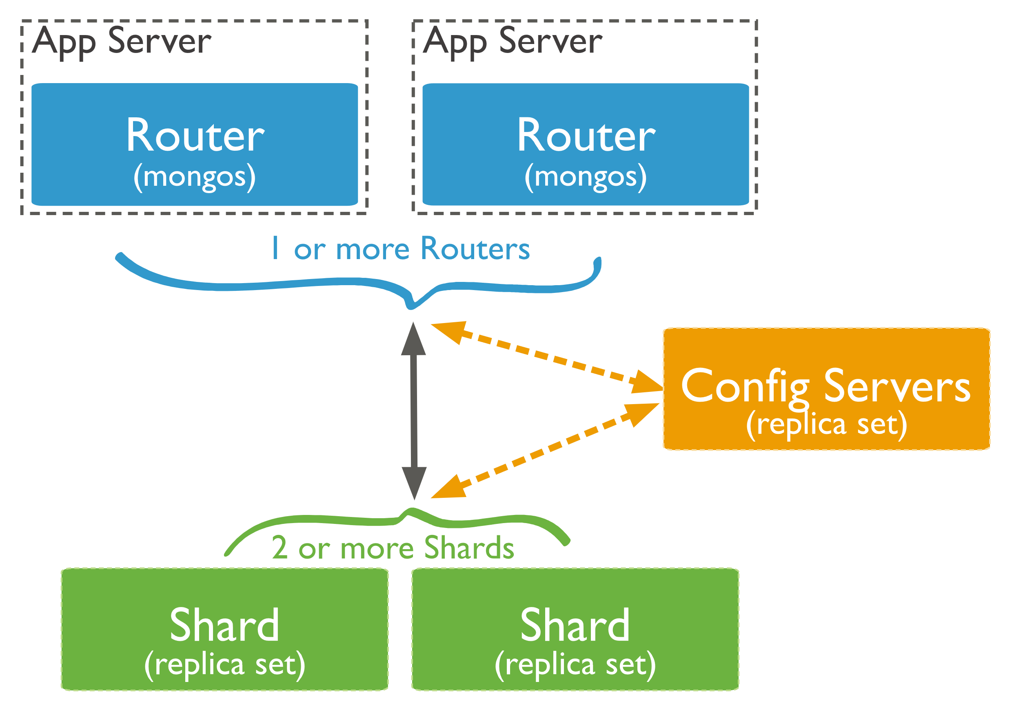
Sharding components
A sharded cluster contains
Shards- a subset of data
Mongos (Routers)- the interface between the shards and user
Config server- handles metadata and settings
A Shard Key distributes the documents across the shards.
The key is unique to each sharded cluster, and can’t be changed

Slide 4
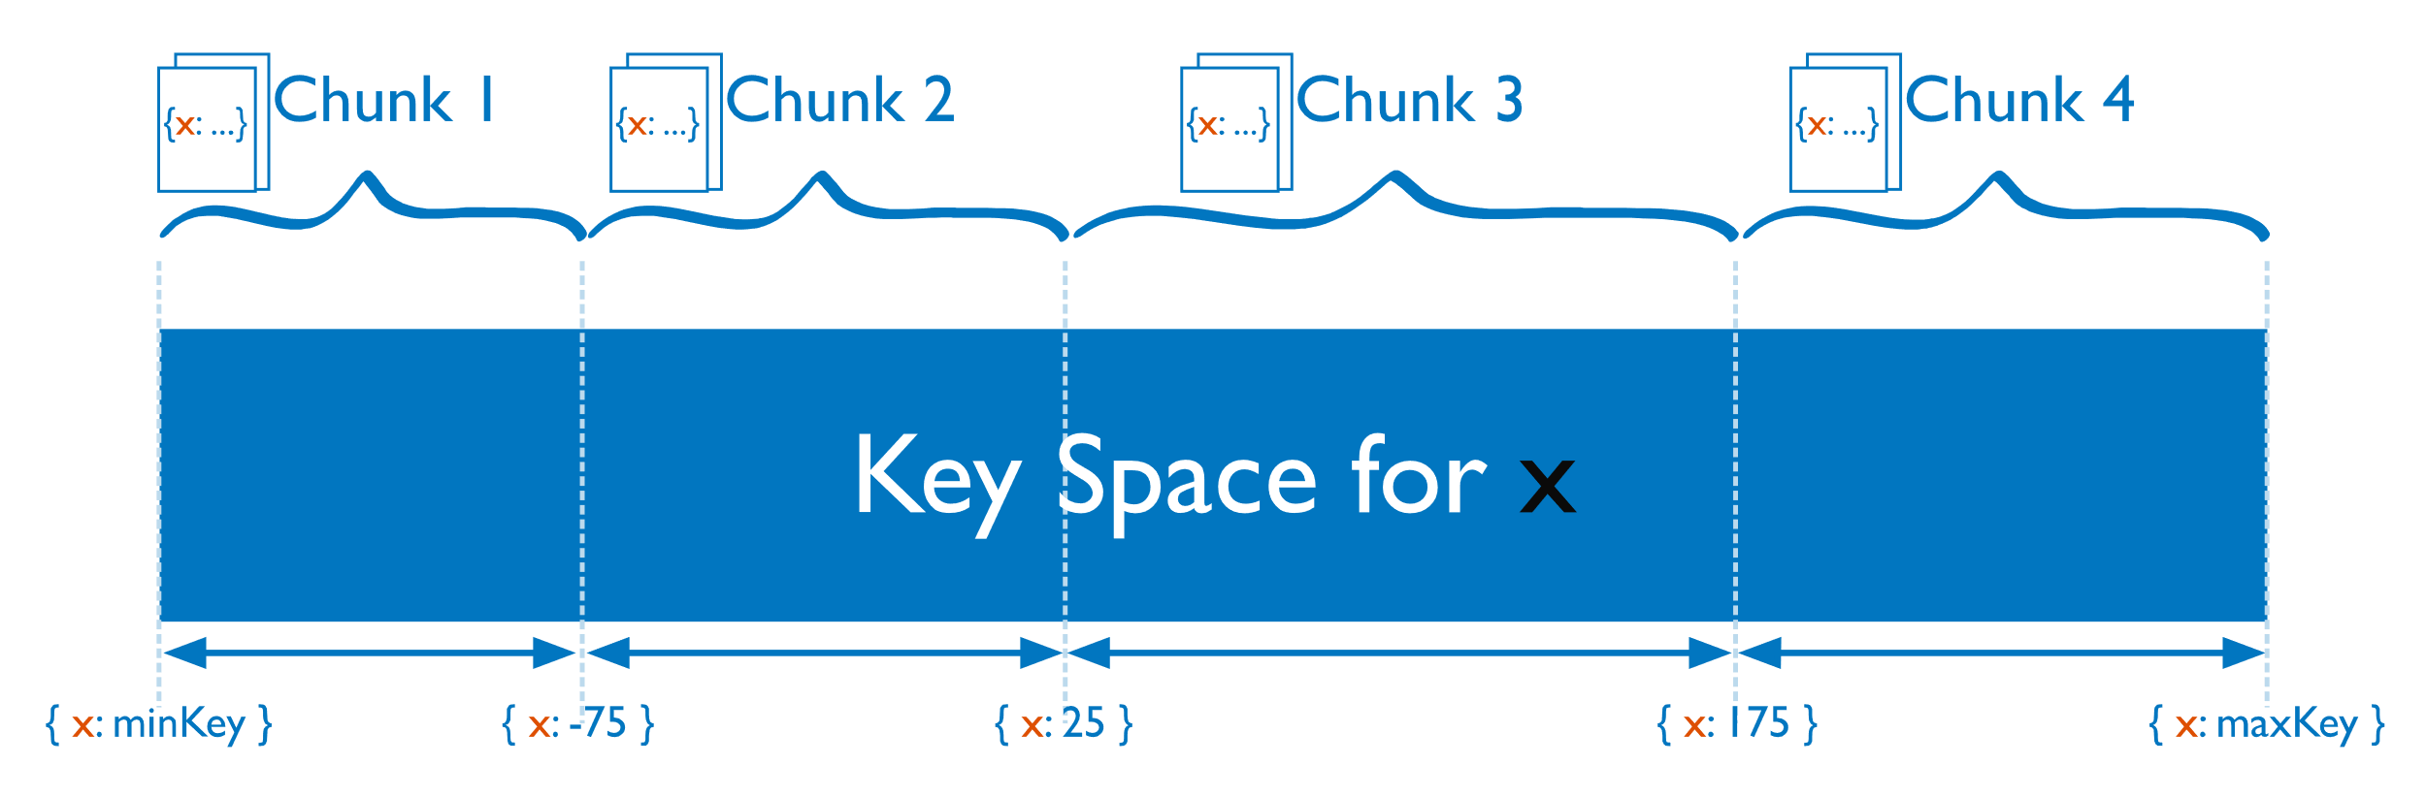
Chunks
The Shard Key also works to partition the data into “Chunks”, which are themselves subsets of the data
The chunks contain a certain set of the keys
MongoDB automatically splits chunks that get too large to improve efficienc

Slide 5

Hashed Sharding
If the Shard Key structure sounds familiar, it’s because MongoDB can use a hash function to distribute your documents
This makes the splitting among shards more even, but splits up documents with similar key values.

Slide 6
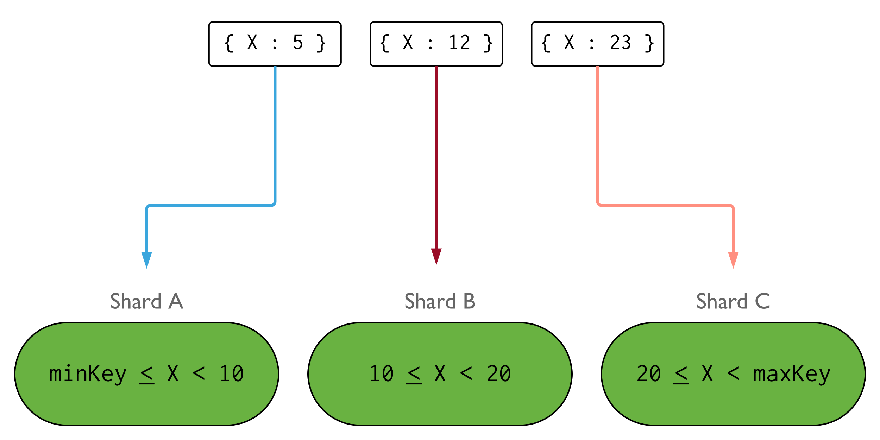
Ranged Sharding
We can overcome the limitations of hashed sharding by using Ranged sharding
Works by putting similar keys in the same shard (for the most part)
However, if keys are chosen poorly, this can decrease performance overall.

Slide 7
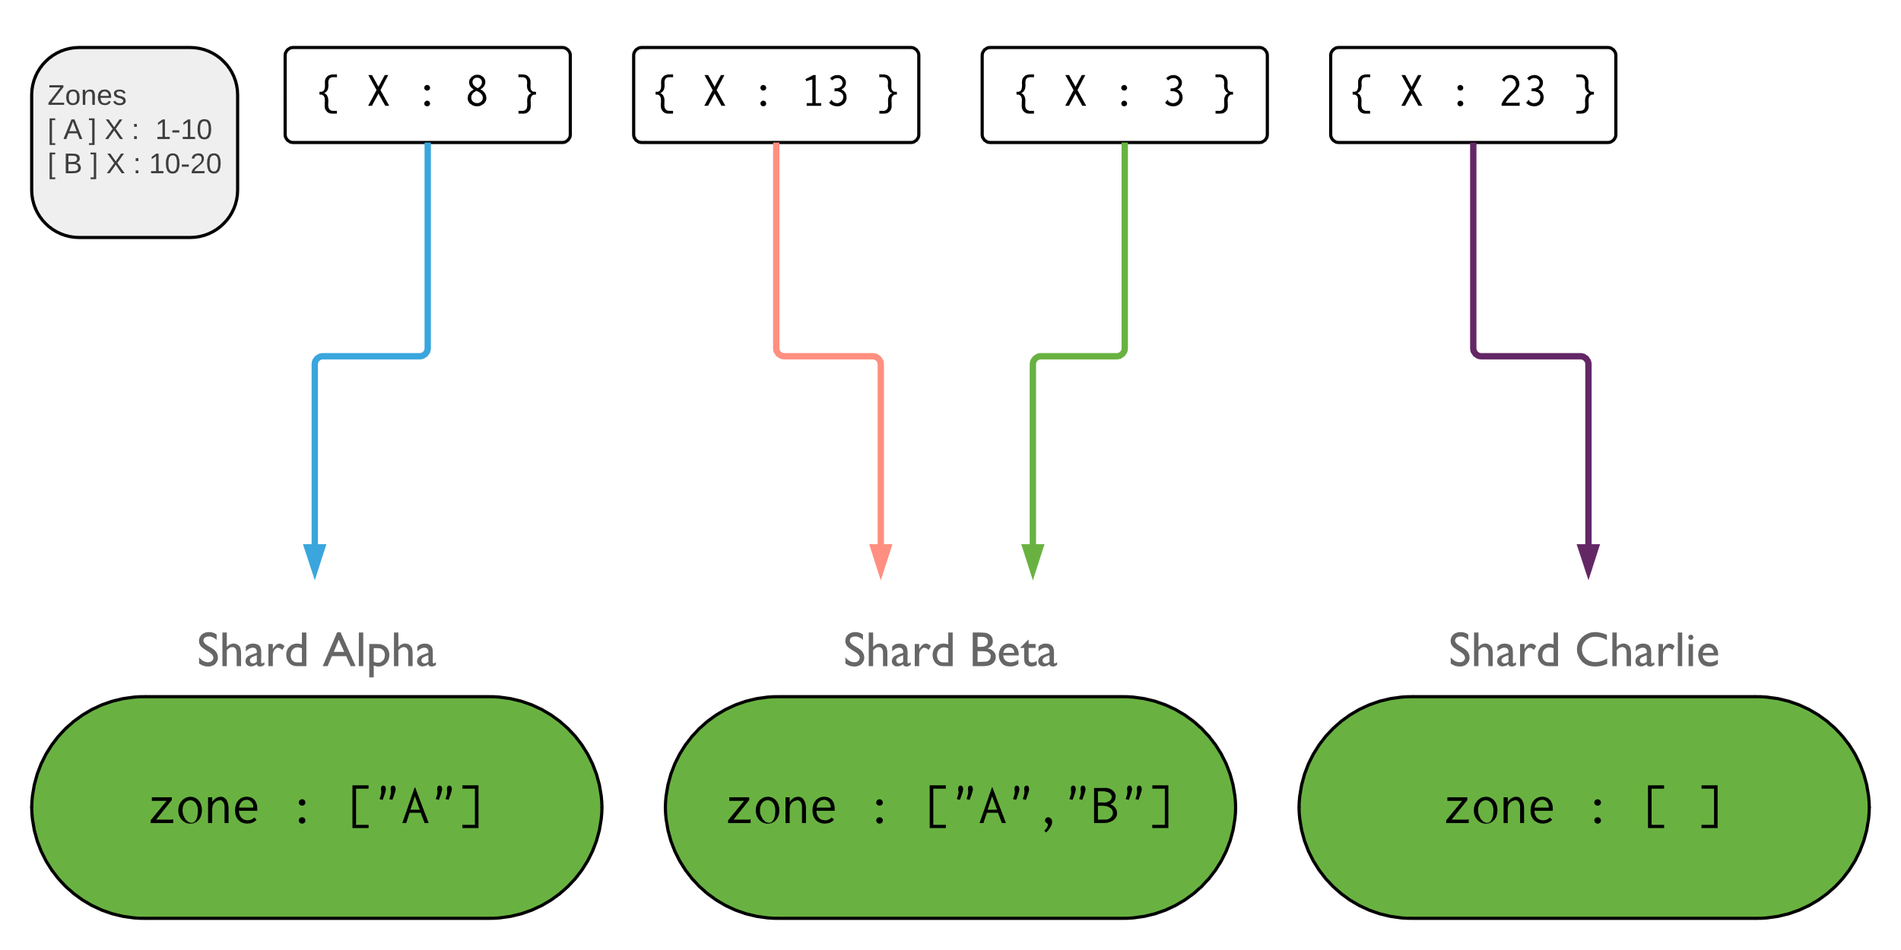
Zoning
We can still organize data in shards through zoning.
Zoning guarantees that certain subsets of data can be found in specific shards
Can help when shards are located at different physical locations- keep data close to those who need it

Slide 8
Why Sharding?
Sharding is useful because data sets are often too large for any one server to handle
Both storage space and cpu usage can be effectively parallelized by sharding the data across multiple machines
It can also localize data that is spread out over a large geographic area
However, this comes at a cost:
Sharding can split up data geographically- increasing the time to get data from other shards
Sharding requires more management resources (rotuers/config servers) in order to function
Sharding depends heavily on the shard key
Performance depends on structure of key
If the key is lost, the data needs to be re-sharded (much like in hashing)

Slide 9
Thank you!
Image sources: https://docs.mongodb.com/manual/sharding/

